Slide 1
OUTDATED
FeatureCollection
FeatureInstance [MAX_FEATURE_INSTANCES ]
FeatureInstance
float fBuffer [MAX_FEATURE_SAMPLES]
ModelCollection
ModelInstance [MAX_MODEL_INSTANCES]
ModelInstance
*FeatureInstance [MAX_FEATURE_DIMENSION]
TrainedModel *
ModelConfig *
union TrainedModel
GmmModel *
GmmModel
GaussComponent [MAX_GAUSSIAN_COMPONENTS]
GaussComponent
union ModelConfig
struct GmmConfig [MAX_GMM_CONFIGS]
GmmConfig
uint8_t feature_ID[MAX_FEATURE_DIMENSION]

Slide 2
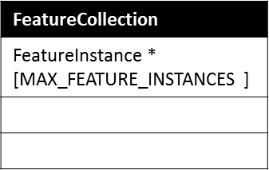



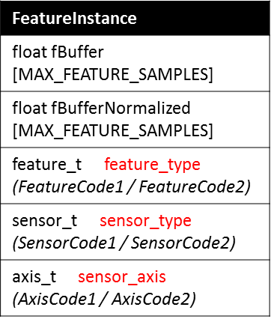
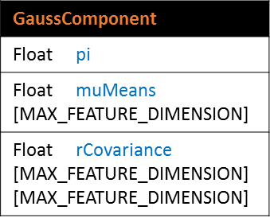
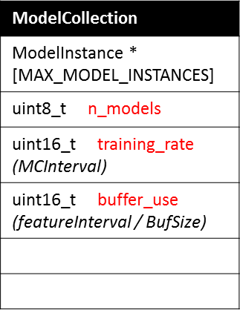
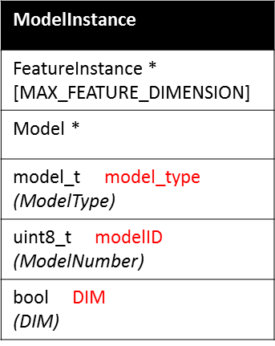
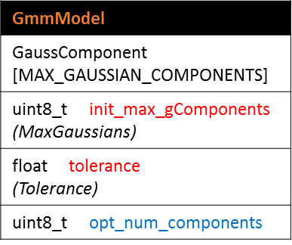
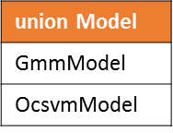
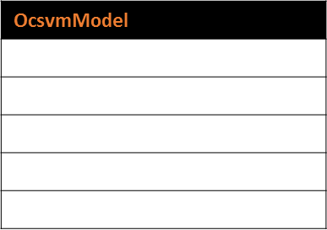

Slide 3
Initial end position = -1;
OUTDATED
Need full_buffer flag = false for first pass through buffer to ensure we don’t grab more samples than are available.
Start position
Start position
End position
Start position
End position
End position-Feature Buffer Size
End position-Feature Buffer Size
End position
Start position
MAX_FEATURE_SAMPLES-1
End position
Next write occurs at mod(end position+1, MAX_FEATURE_SAMPLES)
Gray entries are those required for model training when Feature buffer size < max feature samples.

Slide 4
Initial end position = -1;
Need full_buffer flag = false for first pass through buffer to ensure we don’t grab more samples than are available.
Start position
End position
End position
Start position
Start position
Start position
End position
MAX_FEATURE_SAMPLES-1
End position
Next write occurs at mod(end position+1, MAX_FEATURE_SAMPLES)
Gray entries are those required for model training when Feature buffer size < max feature samples.

Slide 5
Memory Map
0x 2002 FFFF
cstack
DATA
Controlled by __size_cstack__ in linker file
0x 2002 FBFF
heap
Controlled by __size_heap__ in linker file
block ZI
pvPortMalloc() assigns here
heap_4.o
Controlled by configTOTAL_HEAP_SIZE
configMINIMAL_STACK_SIZE affects this size. It is also used to indicate “usStackDepth” of xTaskCreate().
block RW
0x 2000 0000
0x 001F FFFF
TEXT
0x 0000 0410
0x 0000 040F
flash_config
0x 0000 0400
0x 0000 03FF
interrupts
0x 0000 0000

Slide 6
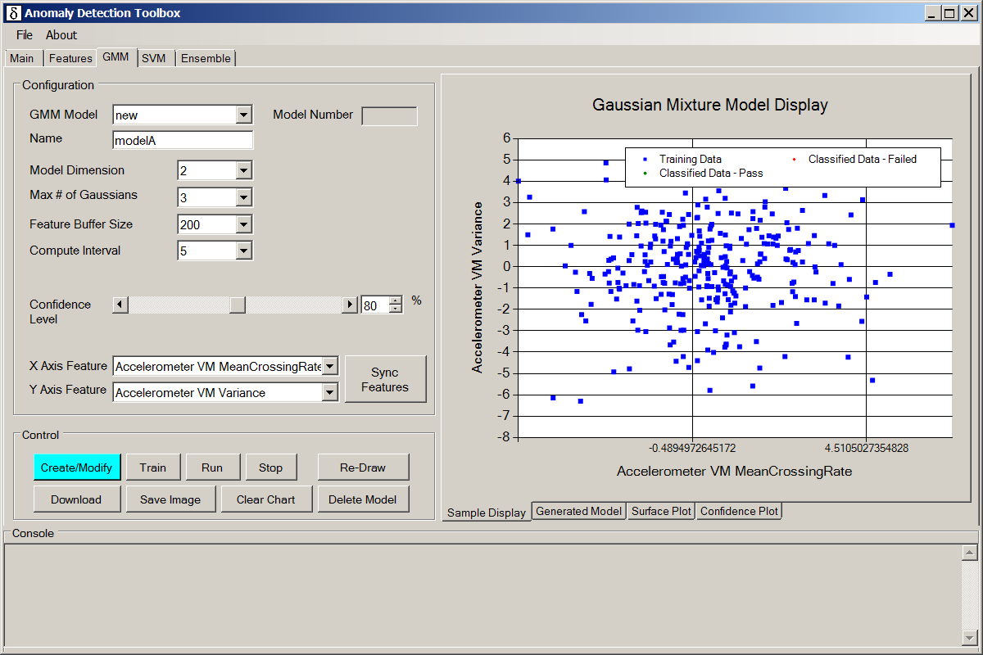
comboBoxGmmModelChoice
textBoxGmmNewName
comboBoxGmmDimension
comboBoxMaxGaussians
comboBoxGmmFeatureBufferSize
comboBoxGmmComputeInterval
scrollBarGmmConfidenceLevel
buttonUpdateFeatureSelections2
comboBoxGmmFeature1
numericUpDownGmmConfidenceLevel
comboBoxGmmFeature2
buttonApplyGmm
buttonGmmStartTraining
buttonGmmStop
buttonRedrawGmm
buttonDownloadGmmModel
tabControlGmmDetails
buttonGmmDeleteModel
TabPages are:
tabGmmDisplay
tabGmmModel
tabGmmSurfacePlot
tabGmmConfidencePlot
buttonGmmRun
buttonSaveGmmImage
buttonGmmClear

Slide 7
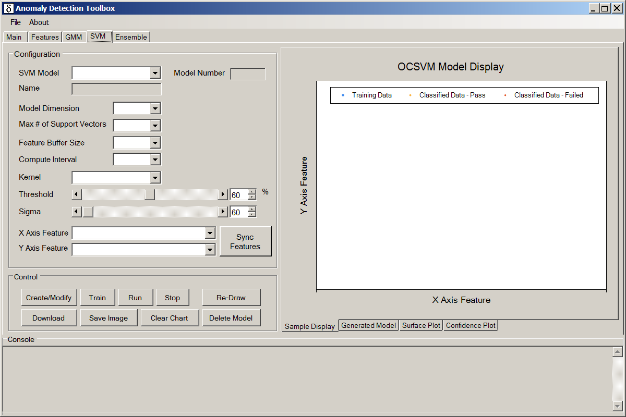
comboBoxSvmModelChoice
textBoxSvmNewName
comboBoxSvmDimension
comboBoxMaxSvmSupportVectors
comboBoxSvmFeatureBufferSize
comboBoxSvmComputeInterval
comboBoxSvmKernel
scrollBarSvmConfidenceLevel
numericUpDownSvmConfidenceLevel
hScrollBarSvmSigma
numericUpDownSvmSigma
comboBoxSvmFeature1
comboBoxSvmFeature2
buttonUpdateFeatureSelections2
buttonApplySvm
buttonSvmStartTraining
buttonSvmStop
buttonRedrawSvm
buttonDownloadSvmModel
tabControlSvmDetails
buttonSvmDeleteModel
TabPages are:
tabSvmDisplay
tabSvmModel
tabSvmSurfacePlot
tabSvmConfidencePlot
buttonSvmRun
buttonSaveSvmImage
buttonSvmClear

Slide 8
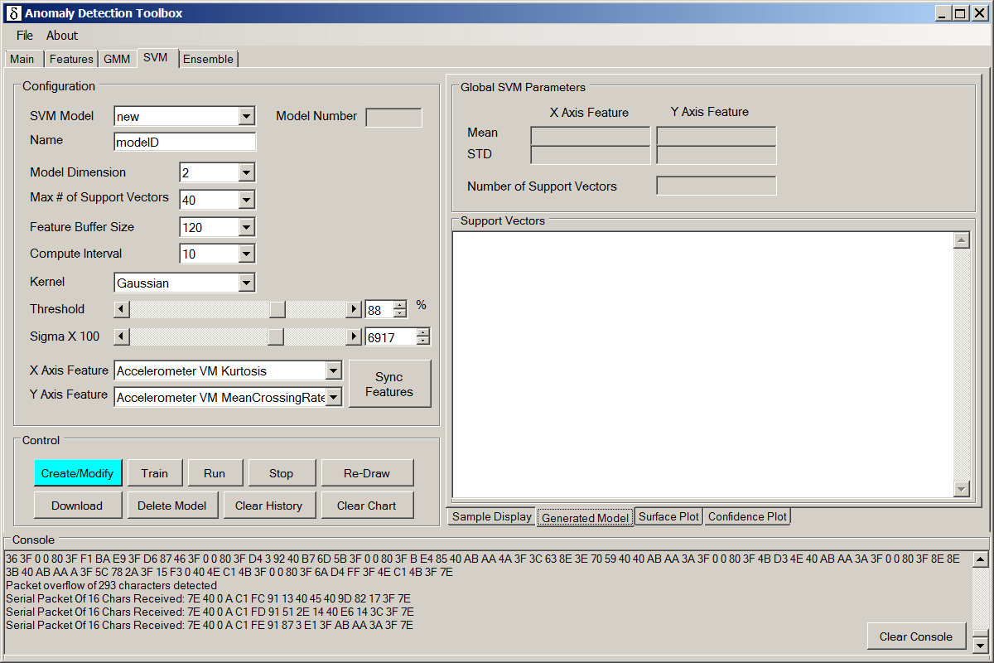
textBoxSvmXAxisMean
textBoxSvmYAxisMean
textBoxSvmYAxisStd
textBoxActualNumberOfSupportVectors
textBoxSvmXAxisStd
textBoxSvmSupportVectors

Slide 9
TN
Red = Anomaly
Green = Nominal
Circle = Prediction Error
FP
TP
FN
Predicted region of nominal behavior
TN
Region of Abnormal behavior
TN

Slide 10
Region B
Region C
Nominal Behavior
Voting = at least 1
Region A

Slide 11
Region A
Overlap area is the expected
region of nominal behavior
Voting = at least 2
Region B

Slide 12
ORed area is the expected
region of nominal behavior
Region A
Voting = at least 1
Region B

Slide 13
read_task()
feature_task()
ml_task()
Host_IO_Receive()
process_host_command()
device_info_command
feature enable/disable
set Gmm Configuration
set SVM Configuration
set Ensemble Configuration
processSetModelModeCommand()
Read Sample Rates
disableAllModels (STOP)
process_ML_command()
RUN Command
Train Command
Train Ensemble Dependencies
Functions not clearing the global command:
DeviceInfo
feature enable/disable
read sample rates

